Slide 1

ICT sector 2008 - 2016
19. srpnja 2017.
Hrvoje Balen, dopredsjednik HUP ICT

Slide 2

ICT sector
rICT | Description
ICTTOT | ICT Total
ICTman | ICT manufacturing industries
261 | Manufacture of electronic components and boards
262 | Manufacture of computers and peripheral equipment
263 | Manufacture of communication equipment
264 | Manufacture of consumer electronics
268 | Manufacture of magnetic and optical media
ICTtotser | ICT total services
ICTtrade | ICT trade industries
4651 | Wholesale of computers, computer peripheral equipment and software
4652 | Wholesale of electronic and telecommunications equipment and parts
ICTser | ICT services industries
5820 | Software publishing
61 | Telecommunications
62 | Computer programming, consultancy and related activities
631 | Data processing, hosting and related activities; web portals
951 | Repair of computers and communication equipment

Slide 3
ICT sector – largest branches (HR)
NACE | DESCRIPTION | REVENUE | COMPANIES
61 | Telecommunications | 13.062.583.964,00 kn | HT, VIPNET, TELE2, OPTIMA, ISKON…
62 | Computer programming, consultancy and related activities | 7.689.485.635,00 kn | SPAN, APIS, COMPING, ASSECO, IN2...
262 | Manufacture of computers and peripheral equipment | 3.990.624.565,00 kn | M SAN GRUPA, KING ICT, MICROLINE, LINKS, COMTEL, CS, COMPUTECH, STORM, KODEKS…
263 | Manufacture of communication equipment | 1.962.004.630,00 kn | ERICSSON NIKOLA TESLA, SIEMENS CONVERGENCE CREATORS, RIZ, AC, ELEKTROKEM...
4651 | Wholesale of computers, computer peripheral equipment and software | 1.231.898.785,00 kn | EUROTRADE, MAKROMIKRO, HSM, BCC SERVICES...
631 | Data processing, hosting and related activities; web portals | 1.087.786.205,00 kn | MERCURY PROCESSING, INFOBIP, ERSTE GROUP IT, HP PRODUKCIJA, ALTIORA, VIP-DATA, GOOGLE HRVATSKA…

Slide 4

ICT sector Total

Slide 5
ICT sector Total

Slide 6
ICT sector Total

Slide 7
ICT sector Total

Slide 8
ICT sector Total

Slide 9
Telecommunications (61)

Slide 10
ICT manufacturing (26.2)

Slide 11
ICT manufacturing (26.3)

Slide 12
Software and IT services (62)

Slide 13
Software and IT services (62)

Slide 14
Software and IT services (62)

Slide 15
Software and IT services (62)

Slide 16
Pokretači industrijske strategije

Slide 17
Pokretači industrijske strategije

Slide 18
Pokretači industrijske strategije

Slide 19



Important Figures 2008-2016
6.200
New Jobs
42
Billion Kn
66
Billion Kn
Extra Employment
Export
Added Value

Slide 20
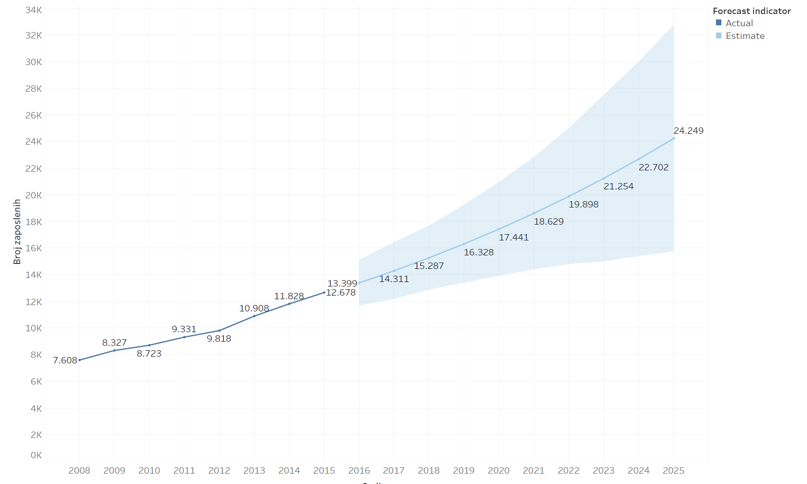
Simulacija rasta

