Slide 1


ICT sektor
7. srpnja 2016.
Hrvoje Balen, dopredsjednik HUP ICT

Slide 2

ICT sektor
rICT | Description
ICTTOT | ICT Total
ICTman | ICT manufacturing industries
261 | Manufacture of electronic components and boards
262 | Manufacture of computers and peripheral equipment
263 | Manufacture of communication equipment
264 | Manufacture of consumer electronics
268 | Manufacture of magnetic and optical media
ICTtotser | ICT total services
ICTtrade | ICT trade industries
4651 | Wholesale of computers, computer peripheral equipment and software
4652 | Wholesale of electronic and telecommunications equipment and parts
ICTser | ICT services industries
5820 | Software publishing
61 | Telecommunications
62 | Computer programming, consultancy and related activities
631 | Data processing, hosting and related activities; web portals
951 | Repair of computers and communication equipment

Slide 3

ICT sector Total

Slide 4
ICT sector Total

Slide 5
Telecommunications (61)

Slide 6
ICT manufacturing (26)

Slide 7
ICT manufacturing (26)

Slide 8
Software and IT services (62)

Slide 9
Software and IT services (62)

Slide 10
Software and IT services (62)

Slide 11
Izvoz softvera i IT usluga – regije
 | 2011 | 2012 | 2013 | 2014
World | 267.429 | 238.189 | 233.966 | 367.626
Europe | 256.084 | 199.567 | 178.000 | 246.808
European Union (EU 28) | 201.021 | 157.716 | 129.213 | 167.103
Central and Eastern Europe (CEE) | 34.351 | 33.455 | 37.355 | 57.027
Commonwealth of Independent States (CIS) | 5.263 |  | 2.393 | 6.233
Organiz. Of Petroleum Exporting Countries (OPEC) | 416 |  | 2.925 | 4.111
Africa | 416 | 901 | 931 | 1.061
Association of South-East Asian Nations (ASEAN) | 277 | 1.158 | 133 | 1.061
Common Market of the South (MERCOSUR) | 416 | 129 |  | 530
Izvor: Eurostat, World Trade Organization (WTO) i United Nations (UN)
http://www.intracen.org/itc/market-info-tools/trade-statistics/

Slide 12
Izvoz softvera i IT usluga – zemlje
Izvor: Eurostat, World Trade Organization (WTO) i United Nations (UN)
http://www.intracen.org/itc/market-info-tools/trade-statistics/

Slide 13
Pokretači industrijske strategije

Slide 14
Pokretači industrijske strategije

Slide 15
Pokretači industrijske strategije

Slide 16
Pokretači industrijske strategije

Slide 17
Pokretači industrijske strategije

Slide 18
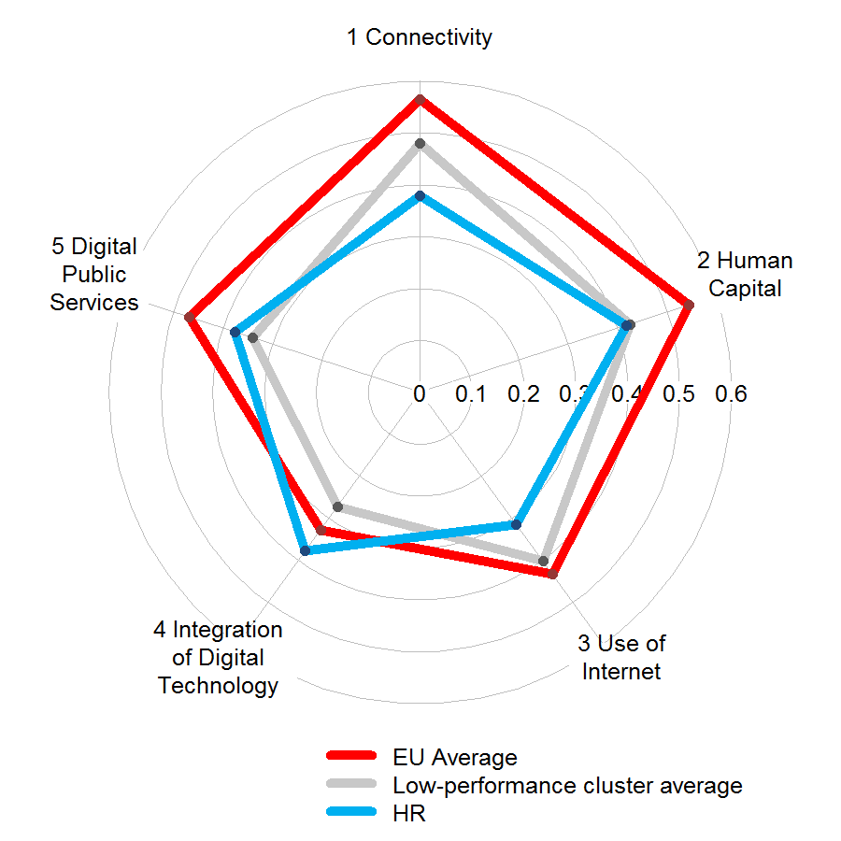
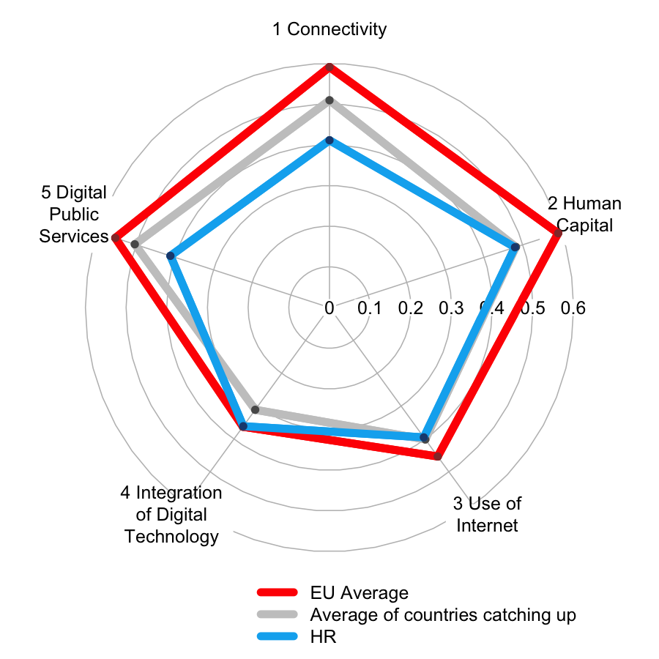
Croatia's performance in the DESI 2016 vs. 2015
2015 2016

Slide 19
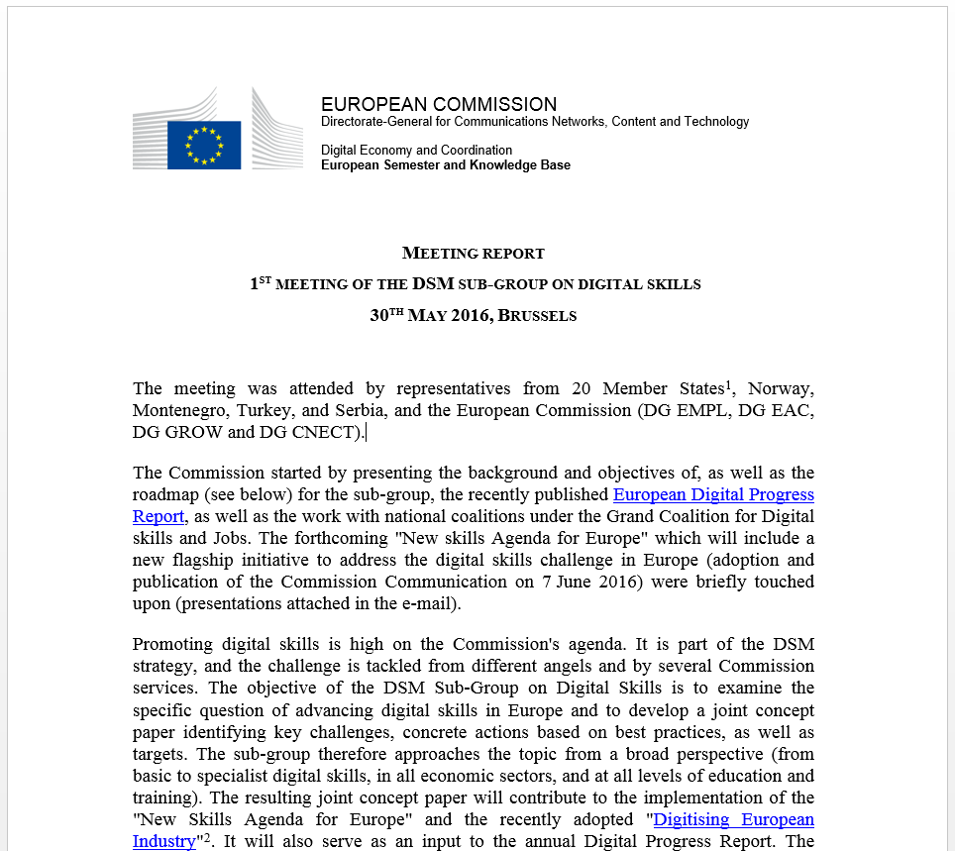
Ljudi kao zajednički EU izazov

